Slide 1

TITLE:
Clustering Global Development
P-498 : GROPU-5

Slide 2
Clustering Global Development
Behind the Project:
SUDHEER KUMAR
RAVULA AKHIL
HRISHIKESH RAJENDRA
SHAIK NABI
SHAIK AYUB BIN TUFEAL
SIDDHARTH SUBHASH
SARVMBH SAWANT

Slide 3
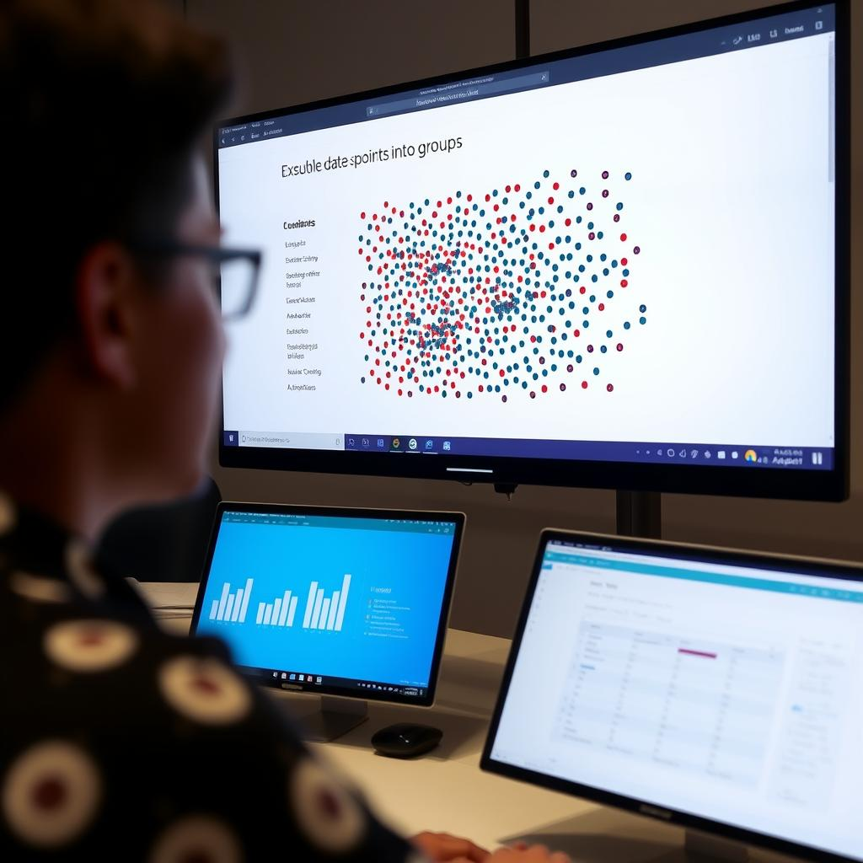
TABLE OF CONTENT:
Introduction
Data Set Information
Technology Stack
Streamlit Overview
Evaluating Clustering Performance
Challenges and Limitations in Clustering Analysis
Practical Applications
Real-World Case Studies
Future Trends and Emerging Technologies
Conclusion

Slide 4
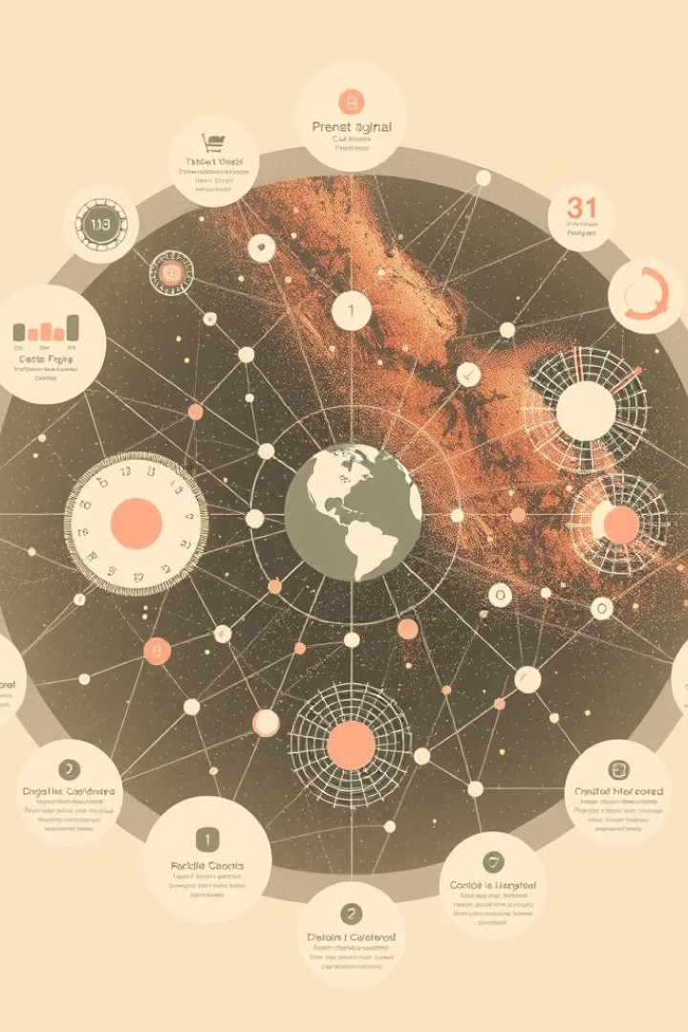
INTRODUCTION:
Clustering Analysis: Transforming Complex Data into Meaningful Insights
Clustering analysis is a powerful technique used in data science to identify groups or clusters of similar objects within a larger dataset. It allows us to uncover hidden patterns, understand relationships between data points, and derive valuable insights. This presentation will delve into the fundamentals of clustering, explore key algorithms, discuss practical applications, and highlight emerging trends in the field.

Slide 5
The Fundamental Role of Clustering in Modern Data Science
Data Reduction and Simplification
Pattern Recognition and Discovery
Decision-Making and Optimization
Clustering helps to reduce the complexity of large datasets by grouping similar data points together, making it easier to analyze and interpret. This is especially valuable for data-intensive applications.
By identifying clusters, we can uncover hidden patterns and relationships within the data that might not be obvious through simple observation. This can lead to valuable insights and knowledge discovery.
Clustering results can inform decision-making processes by providing insights into customer behavior, product preferences, and market trends, helping to optimize operations and strategies.

Slide 6
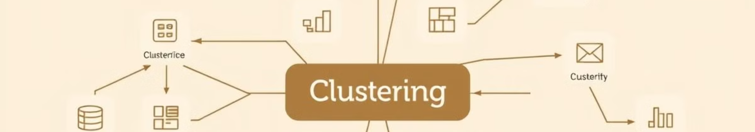
Key Clustering Algorithms: K-means, DBSCAN, and Hierarchical Methods
1
K-means
2
DBSCAN (Density-Based Spatial Clustering of Applications with Noise)
3
Hierarchical Clustering
A popular partitioning algorithm that assigns data points to K clusters based on their proximity to cluster centroids. It's known for its simplicity and efficiency.
A method that creates a hierarchy of clusters, starting with individual data points and merging or splitting clusters iteratively based on their similarity or distance.
An algorithm that groups data points based on their density, identifying clusters of high density and separating them from noise or outliers.

Slide 7
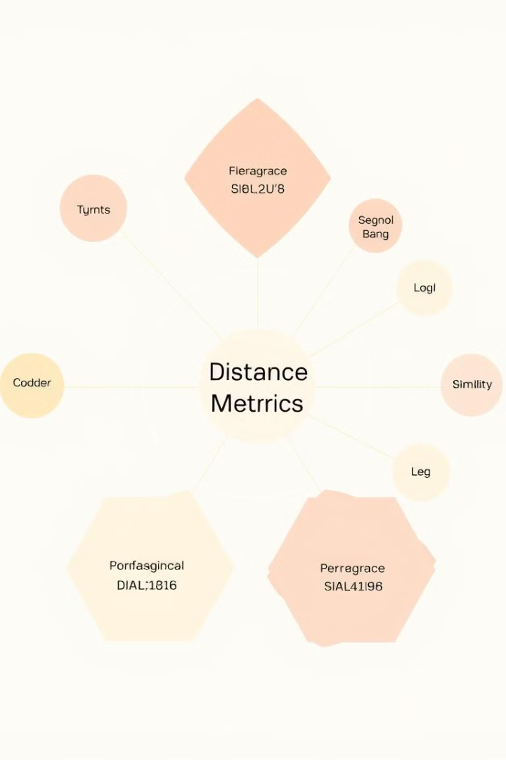
Mathematical Foundations: Distance Metrics and Similarity Measures
Euclidean Distance
The most common distance metric, calculating the straight-line distance between two points in a multi-dimensional space.
Manhattan Distance
A distance metric that calculates the sum of absolute differences between corresponding coordinates of two points.
Cosine Similarity
A similarity measure that calculates the cosine of the angle between two vectors, indicating how similar their directions are.
Jaccard Similarity
A similarity measure that calculates the ratio of intersection to union of two sets, commonly used for categorical data.

Slide 8
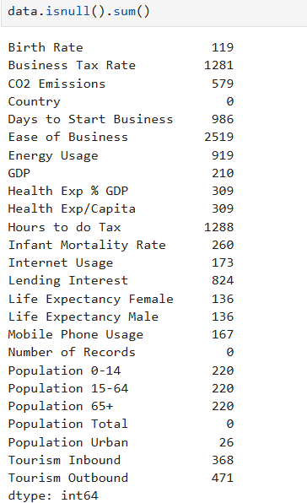
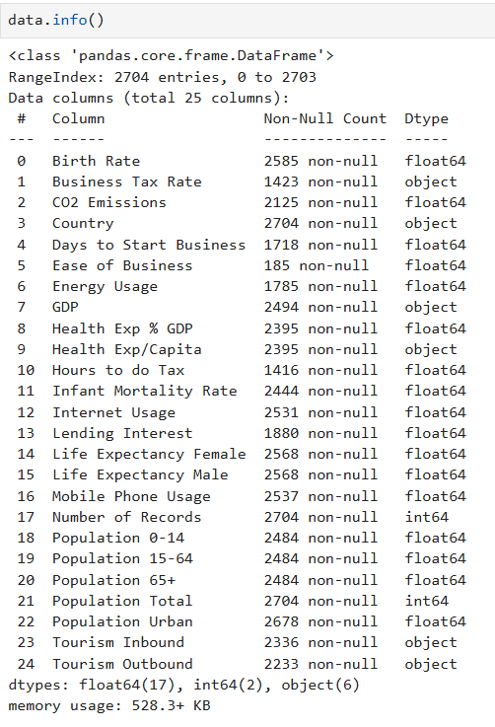
DATA SET INFORMATION AND NULL VALUES
Dataset Structure
Number of Rows: 2704
Number of Columns: 25
Data Type: Mostly numerical
Key Features
Some of the important columns in the dataset include: ✅ Birth Rate – Measures the number of births per 1,000 people. ✅ CO2 Emissions – Represents carbon dioxide emissions per capita. ✅ GDP – Gross Domestic Product of the country. ✅ Energy Usage – Measures per capita energy consumption. ✅ Internet Usage – Percentage of people using the internet. ✅ Life Expectancy (Male & Female) – Average life span by gender.

Slide 9
DATA SET INFORMATION AND NULL VALUES
Handling Missing Values
We applied imputation methods like:
Mean/Median Imputation for numerical features.
Dropping rows where missing data is minimal.
Ensured that missing values do not impact clustering performance.
This structured dataset allows us to apply K-Means Clustering effectively for analysis and visualization. 🚀
Would you like any specific details added?

Slide 10
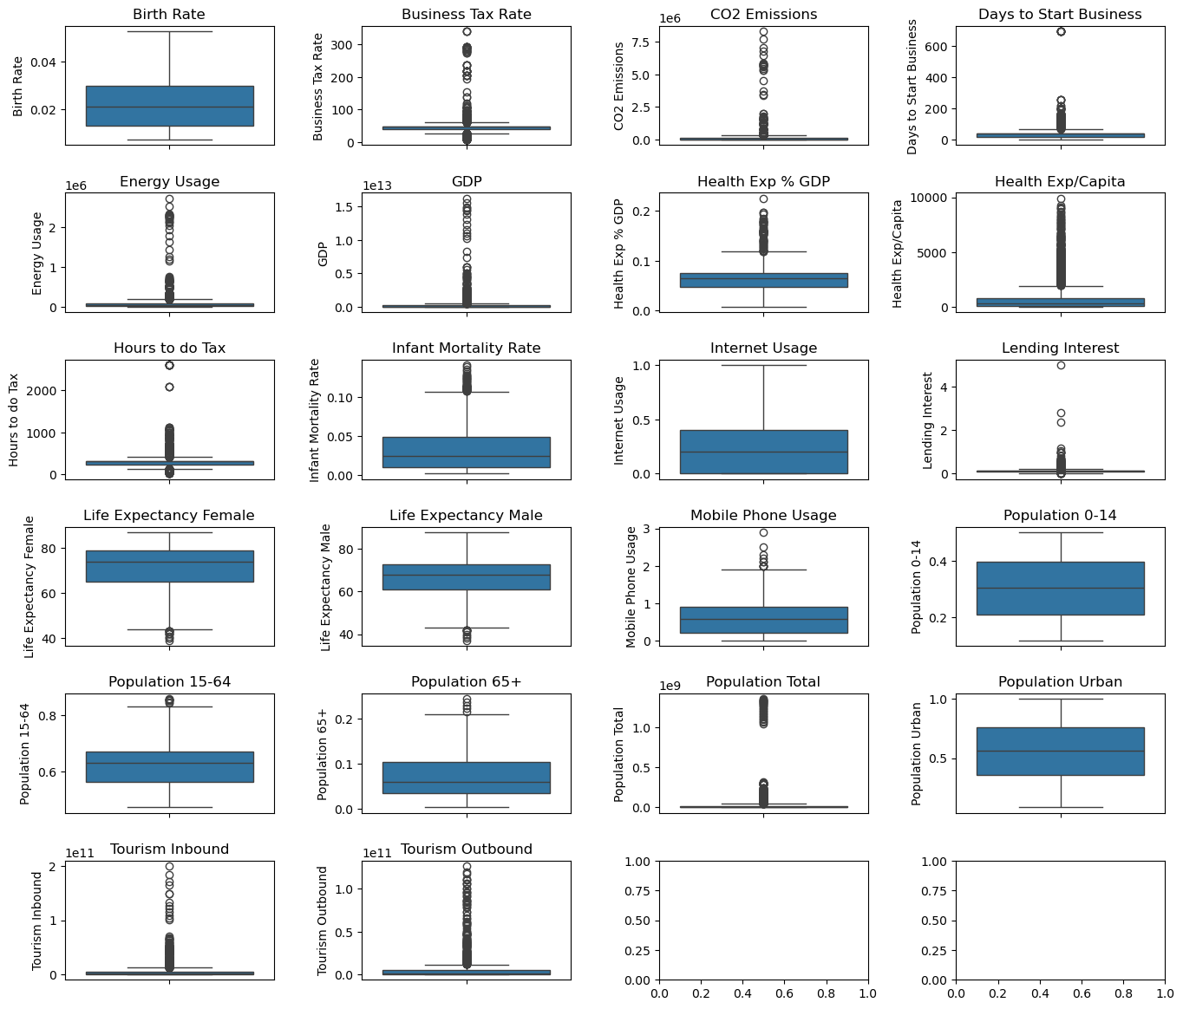
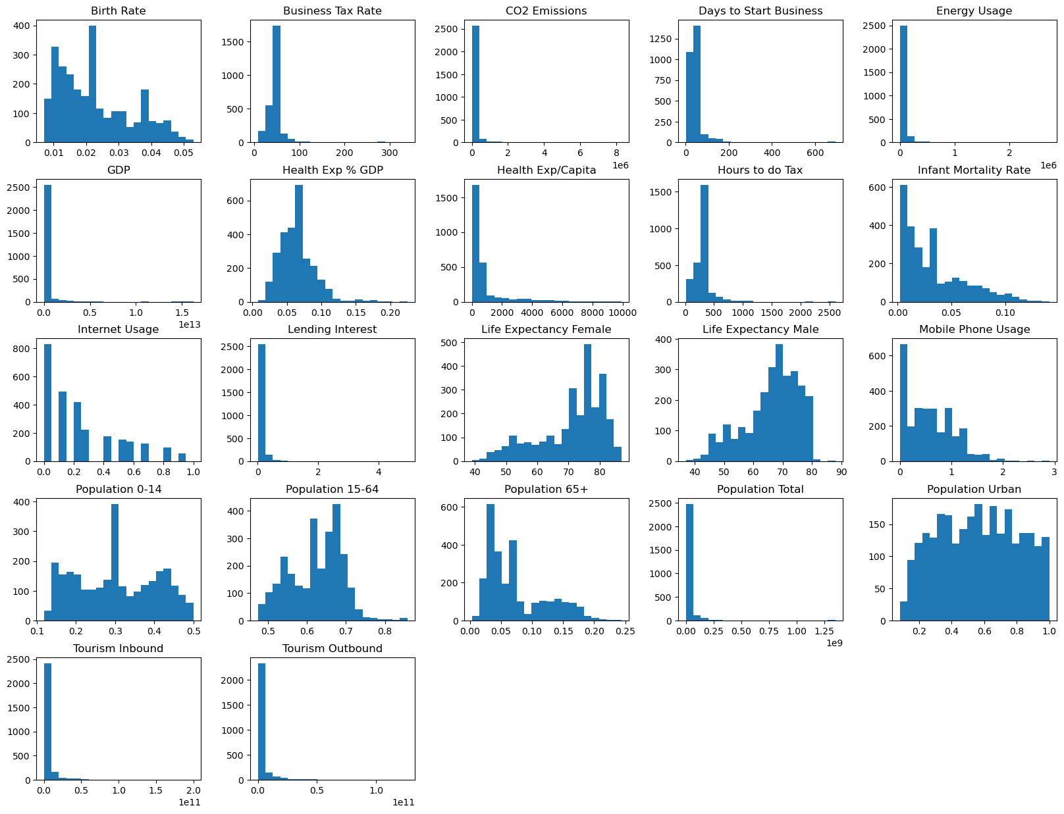
Histogram & Box Plot – Feature Distributions
📌 Histogram:
Used to visualize the distribution of numerical features.
Example: CO2 Emissions, GDP, and Internet Usage show varying spread across different regions
📌 BOXPLOT:
Helps detect outliers and variability in features.
Example: Life Expectancy has a narrow IQR, while Energy Usage shows high variation.

Slide 11
Histogram & Box Plot – Feature Distributions
📌 BOXPLOT:
Helps detect outliers and variability in features.
Example: Life Expectancy has a narrow IQR, while Energy Usage shows high variation.

Slide 12
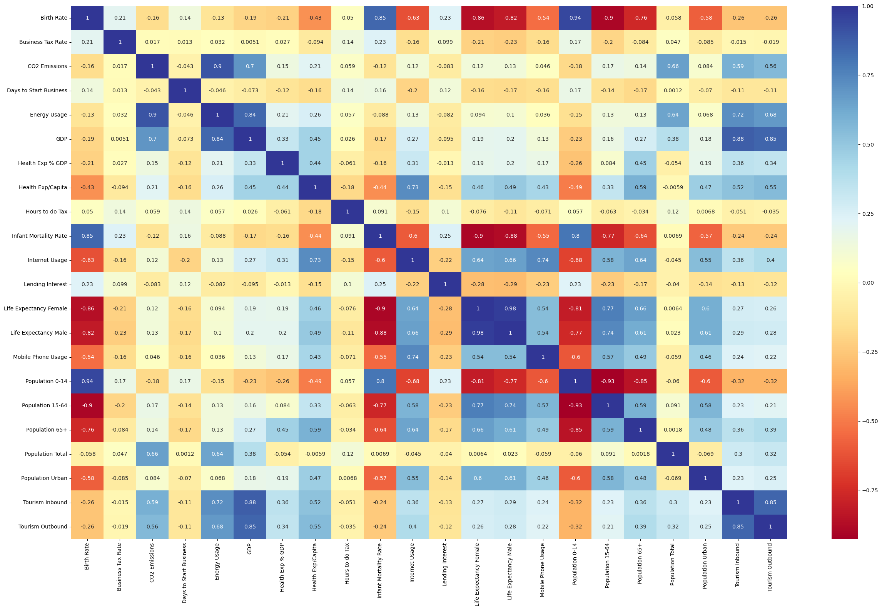
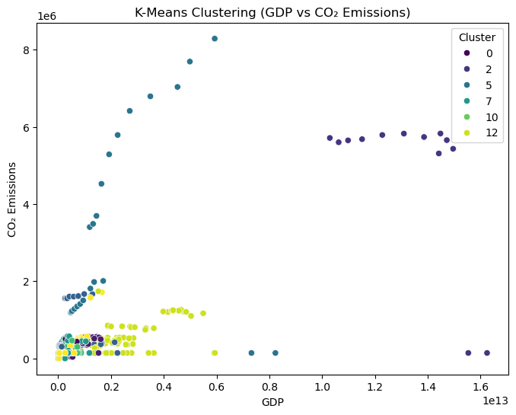
Correlation Heatmap – Understanding Feature Relationships
📌 Purpose:
Displays how strongly numerical variables are related using color intensity.
Helps in feature selection for clustering.
Scatter Plot – Relationship Between Variables
📌 Purpose:
Shows how two variables relate to each other.
Helps identify clusters and trends in the data.

Slide 13
Correlation Heatmap – Understanding Feature Relationships
📌 Purpose:
Displays how strongly numerical variables are related using color intensity.
Helps in feature selection for clustering.

Slide 14

Technology Stack:
1. Programming Language
✅ Python – Chosen for its flexibility, ease of use, and extensive machine learning libraries.
2. Libraries Used
📌 Key Python Libraries: 🔹 Streamlit – Used to build an interactive web app for real-time clustering analysis. 🔹 scikit-learn – Provides the K-Means clustering algorithm and preprocessing tools. 🔹 matplotlib & seaborn – Used for data visualizations like histograms, scatter plots, and heatmaps. 🔹 pickle – Helps in saving and loading the trained K-Means model efficiently.

Slide 15
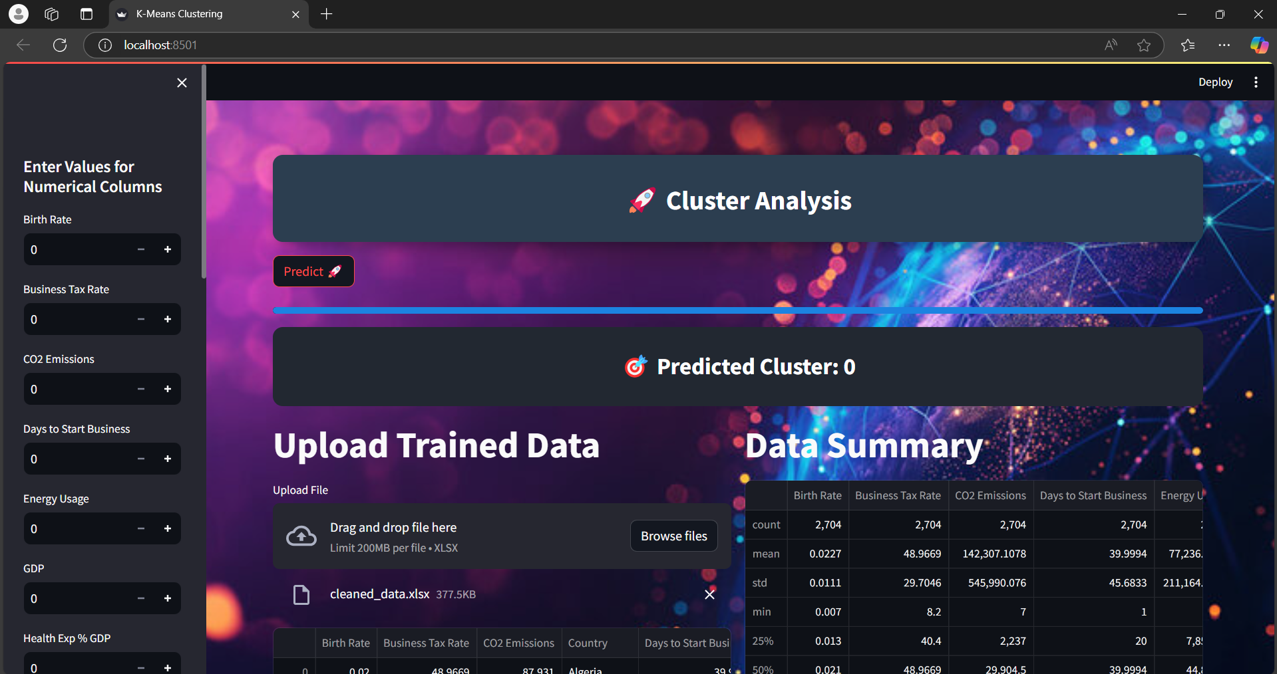
Streamlit App Overview:
Our Streamlit-based app provides an interactive and user-friendly experience for clustering analysis. It allows users to input data, upload datasets, and visualize patterns dynamically.

Slide 16
Streamlit App Overview:
User Input Features
📌 How it Works: 🔹 Users enter 20 numerical feature values through sidebar input fields. 🔹 Input fields are dynamic and support a range of values. 🔹 Once entered, the model processes and predicts the cluster.
✅ Example: A user enters values for GDP, CO2 Emissions, Internet Usage, and other features. The model analyzes patterns and assigns the data to a cluster.

Slide 17
Dataset Upload Feature
📌 How it Works: 🔹 Users can upload a dataset (Excel format). 🔹 The app automatically reads and displays the first few rows. 🔹 Provides summary statistics (mean, median, standard deviation, etc.).
✅ Why? This allows users to analyze their own data and see how clustering applies to real-world datasets.
Streamlit App Overview:

Slide 18
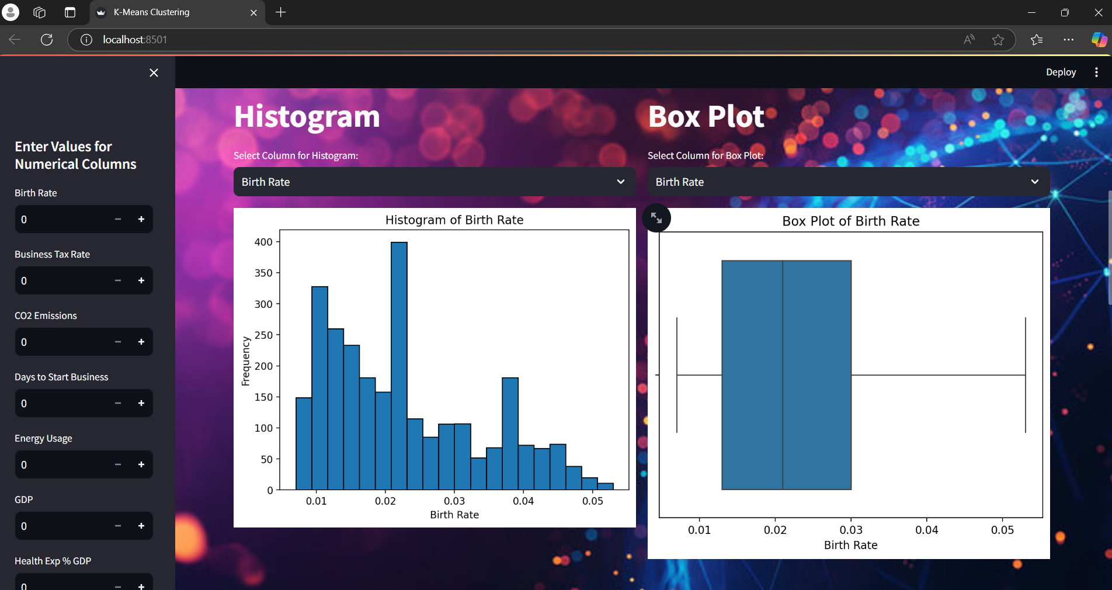
Streamlit App Overview:
Visualization Capabilities
📌 Key Visualizations Included: 🔹 Histogram: Shows feature distributions and value frequencies. 🔹 Box Plot: Helps in detecting outliers and understanding feature spread.

Slide 19
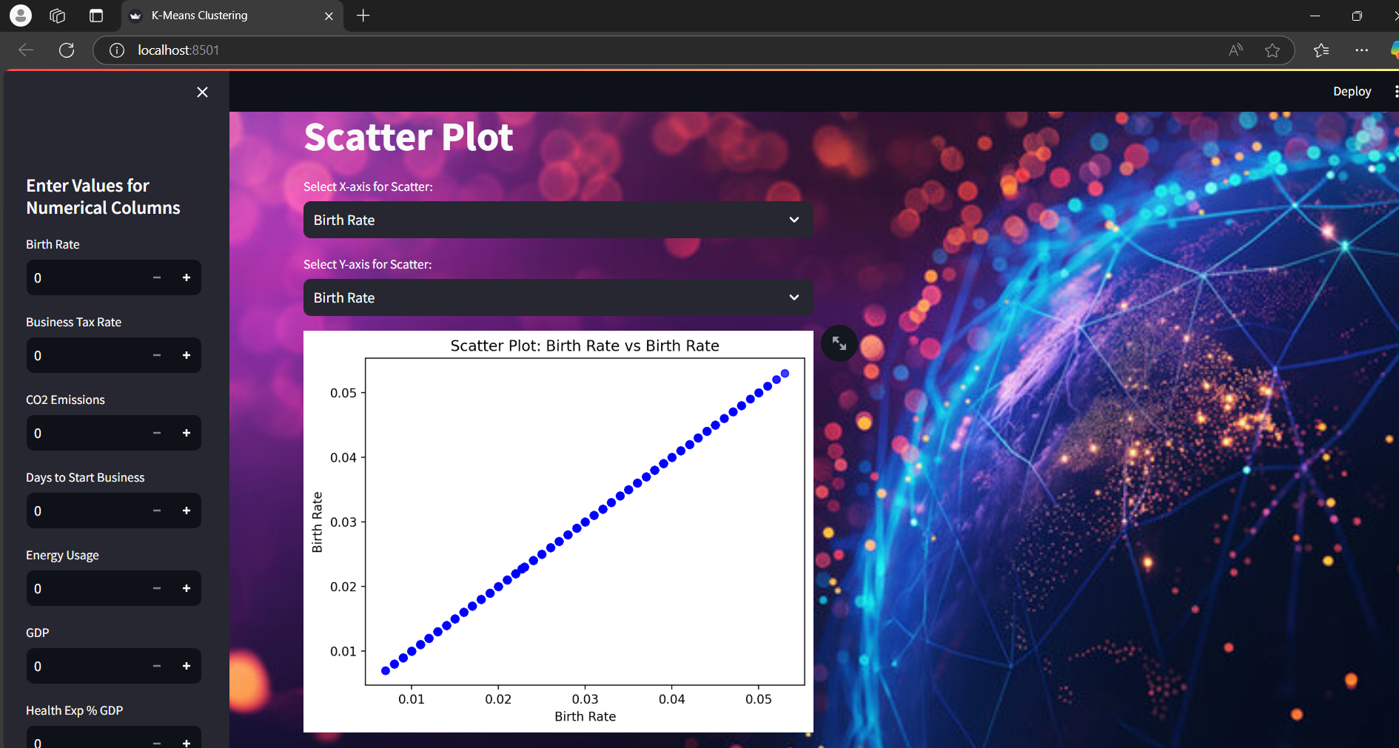
Streamlit App Overview:
Visualization Capabilities
📌 Key Visualizations Included: 🔹 Histogram: Shows feature distributions and value frequencies. 🔹 Box Plot: Helps in detecting outliers and understanding feature spread.

Slide 20
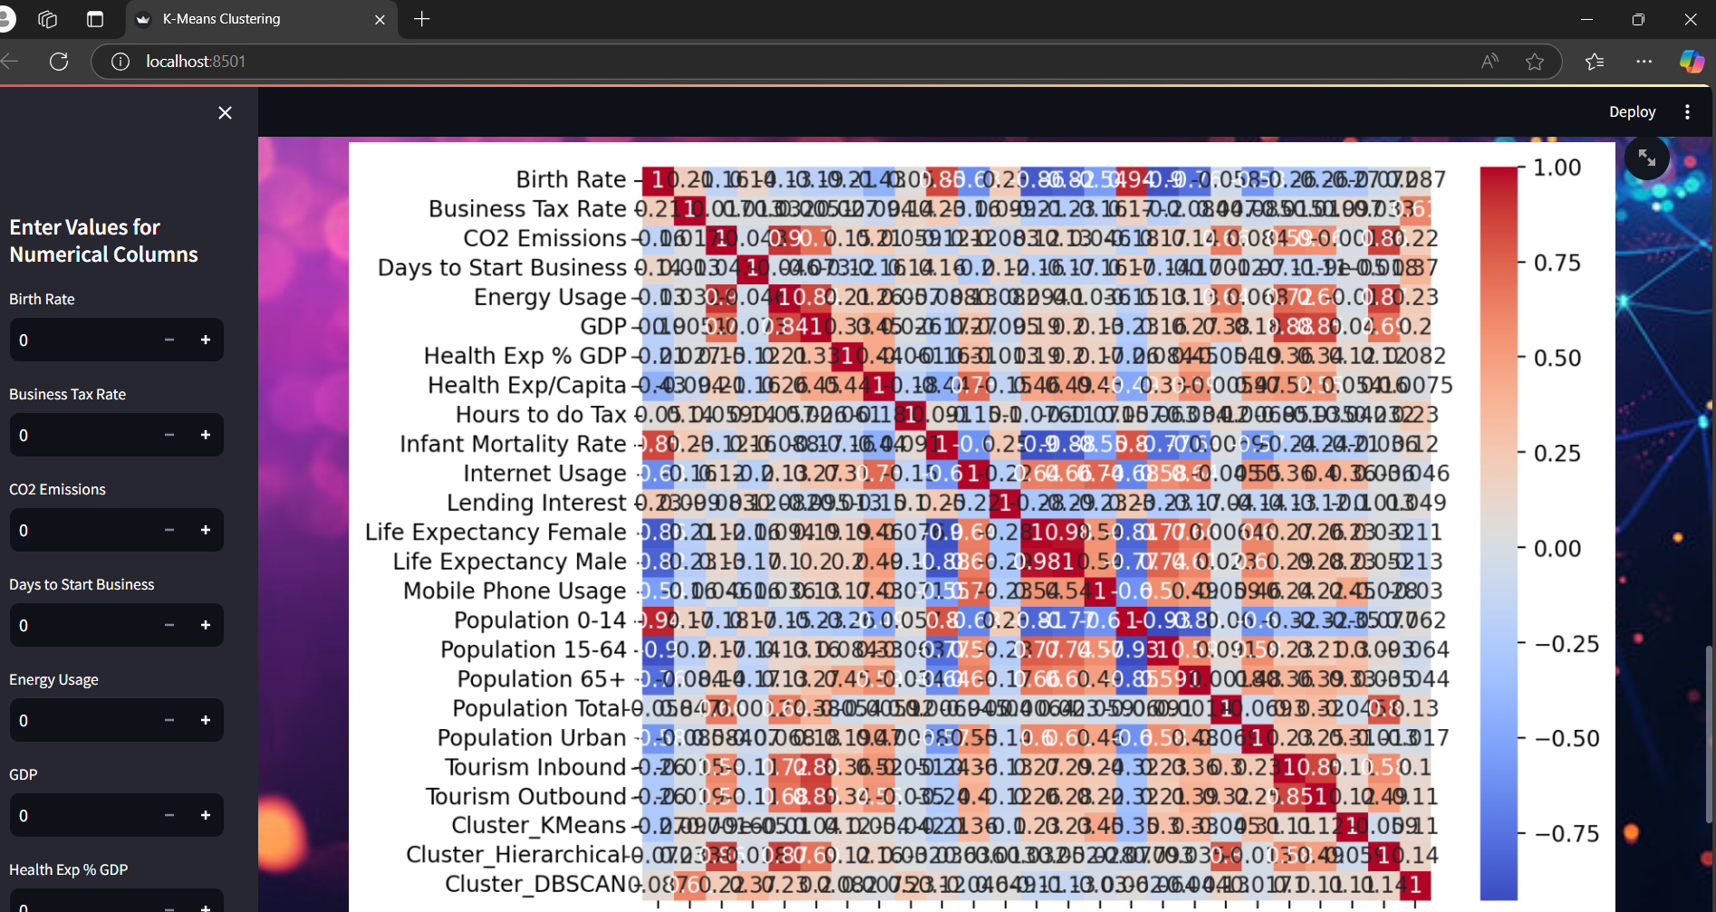
Streamlit App Overview:
Visualization Capabilities
📌 Key Visualizations Included:
Scatter Plot: Displays relationships between two selected features.

Slide 21
Streamlit App Overview:
Visualization Capabilities
📌 Key Visualizations Included:
Correlation Heatmap: Highlights feature relationships for deeper insights..

Slide 22
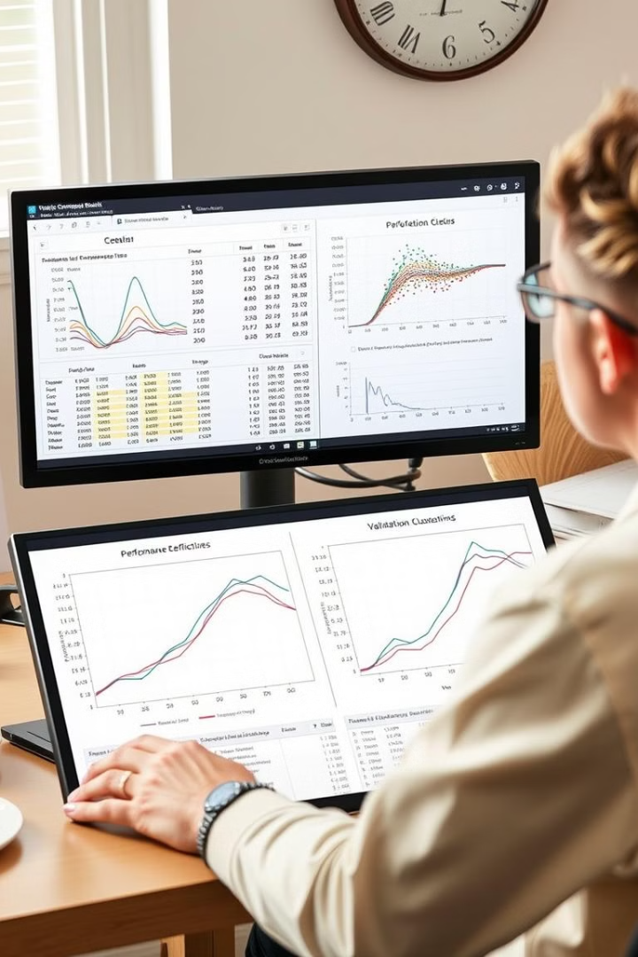
Evaluating Clustering Performance: Metrics and Validation Techniques
1
Silhouette Score
A metric that measures the similarity of data points within their cluster compared to other clusters, indicating the quality of clustering.
2
Dunn Index
A metric that calculates the ratio of minimum inter-cluster distance to maximum intra-cluster distance, representing the separation between clusters.
3
Calinski-Harabasz Index
A metric that measures the ratio of between-cluster variance to within-cluster variance, indicating the overall separation of clusters.

Slide 23
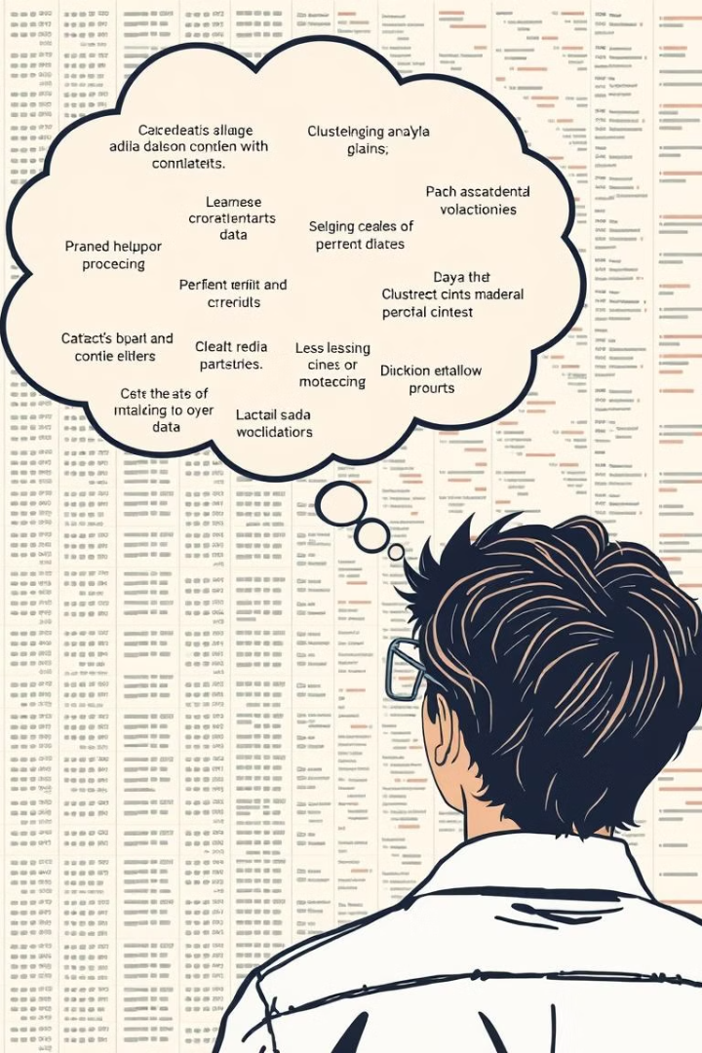

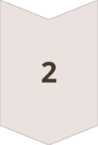

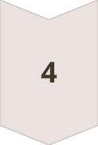
Challenges and Limitations in Clustering Analysis
Determining the Optimal Number of Clusters
Choosing the right number of clusters can be challenging and often requires experimentation with different algorithms and techniques.
Handling High-Dimensional Data
Clustering high-dimensional data can be computationally expensive and prone to noise and outliers, requiring careful data preprocessing.
Sensitivity to Outliers
Clustering algorithms can be sensitive to outliers, which can distort the results and lead to incorrect cluster assignments.
Interpretability and Domain Expertise
Interpreting clustering results requires domain expertise to understand the meaning of clusters and their relevance to specific business problems.

Slide 24
Challenges and Limitations in Clustering Analysis
Determining the Optimal Number of Clusters
Choosing the right number of clusters can be challenging and often requires experimentation with different algorithms and techniques.
Sensitivity to Outliers
Clustering algorithms can be sensitive to outliers, which can distort the results and lead to incorrect cluster assignments.
Handling High-Dimensional Data
Clustering high-dimensional data can be computationally expensive and prone to noise and outliers, requiring careful data preprocessing.
Interpretability and Domain Expertise
Interpreting clustering results requires domain expertise to understand the meaning of clusters and their relevance to specific business problems.

Slide 25
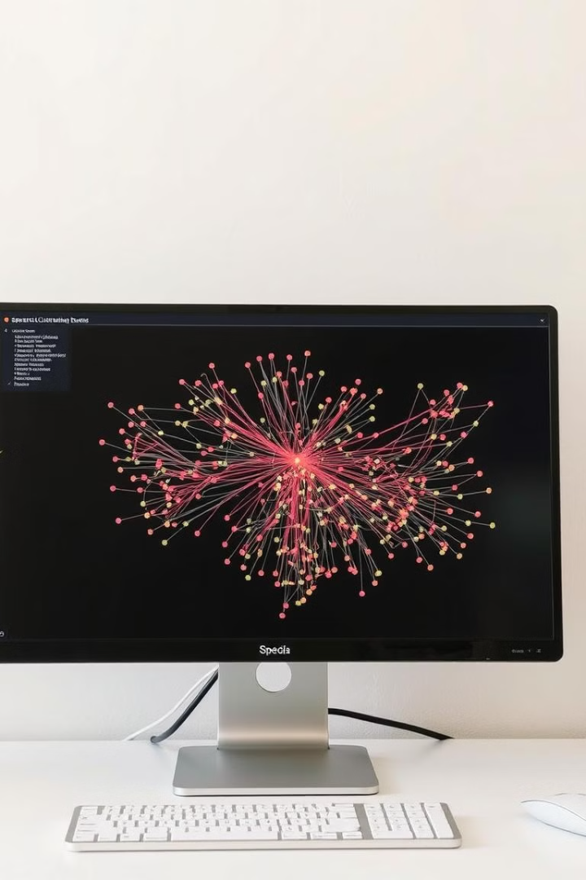
Advanced Techniques: Spectral Clustering and Density-Based Approaches
Spectral Clustering
A technique that uses the spectrum of a similarity matrix to identify clusters, allowing for the discovery of non-convex clusters and handling high-dimensional data.
Density-Based Clustering
A family of algorithms that focus on identifying clusters based on the density of data points, effectively handling non-spherical clusters and dealing with noise.

Slide 26




Practical Applications Across Industries: From Customer Segmentation to Anomaly Detection
Customer Segmentation
Fraud Detection
Image Analysis
Clustering algorithms can identify unusual patterns in financial transactions, helping to detect fraudulent activities and prevent financial losses.
Clustering can be applied to image processing tasks such as object recognition, image segmentation, and noise reduction, improving the quality and interpretation of images.
Clustering can be used to group customers into distinct segments based on their demographics, purchasing behavior, or other characteristics, allowing businesses to tailor marketing campaigns and product offerings.

Slide 27
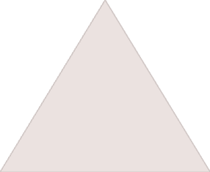


Real-World Case Studies: Successful Clustering Implementations
Customer Segmentation
1
Businesses use clustering to segment customers into distinct groups with similar needs and preferences, enabling personalized marketing campaigns and product offerings.
Fraud Detection
2
Financial institutions utilize clustering to identify fraudulent transactions, preventing losses and enhancing security measures.
Image Analysis
3
Clustering techniques are applied in image processing to perform tasks such as object recognition, image segmentation, and noise reduction.

Slide 28
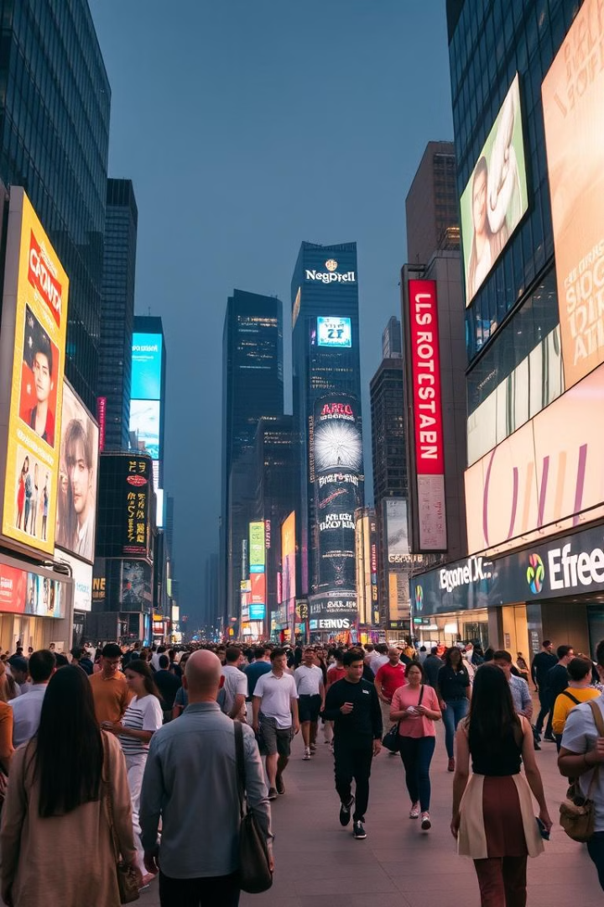
Future Trends and Emerging Technologies in Clustering Research
The field of clustering analysis is constantly evolving, with new algorithms, techniques, and applications emerging. Future trends include the integration of machine learning and artificial intelligence, the development of more robust and scalable algorithms, and the exploration of new applications in areas such as healthcare, finance, and robotics.

Slide 29

Conclusion:
📌 Summary of Findings: ✅ K-Means effectively grouped data into meaningful clusters. ✅ Visualizations (histograms, scatter plots, heatmaps) provided valuable insights. ✅ Streamlit app enables real-time user interaction and clustering predictions.
📌 Final Thoughts: 🔹 Choosing the right K value is crucial. 🔹 Proper data preprocessing improves accuracy. 🔹 User-friendly UI enhances accessibility.

